Slide 1
Linear Algebra
Lecture 4

Slide 2
Systems of
Linear Equations

Slide 3
Row Reduction
and Echelon Form

Slide 4
Echelon Form
All nonzero rows are above any rows of all zeros.
Each leading entry of a row is in a column to the right of the leading entry of the row above it.
All entries in a column below a leading entry are zero.

Slide 5
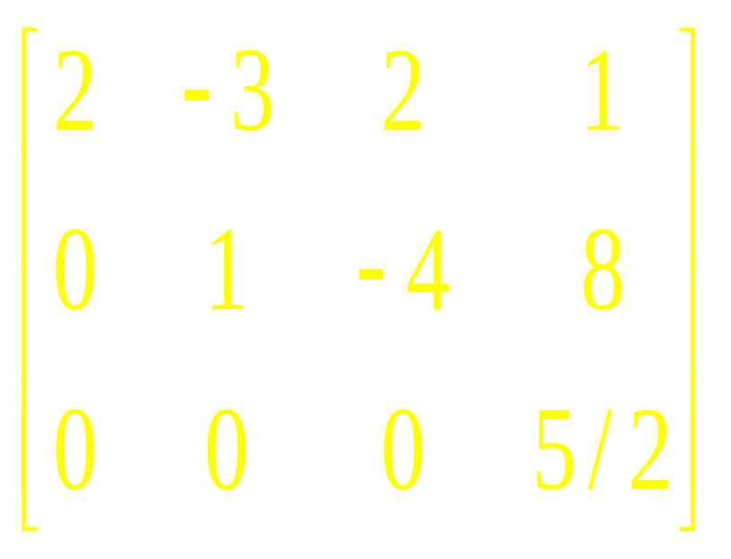
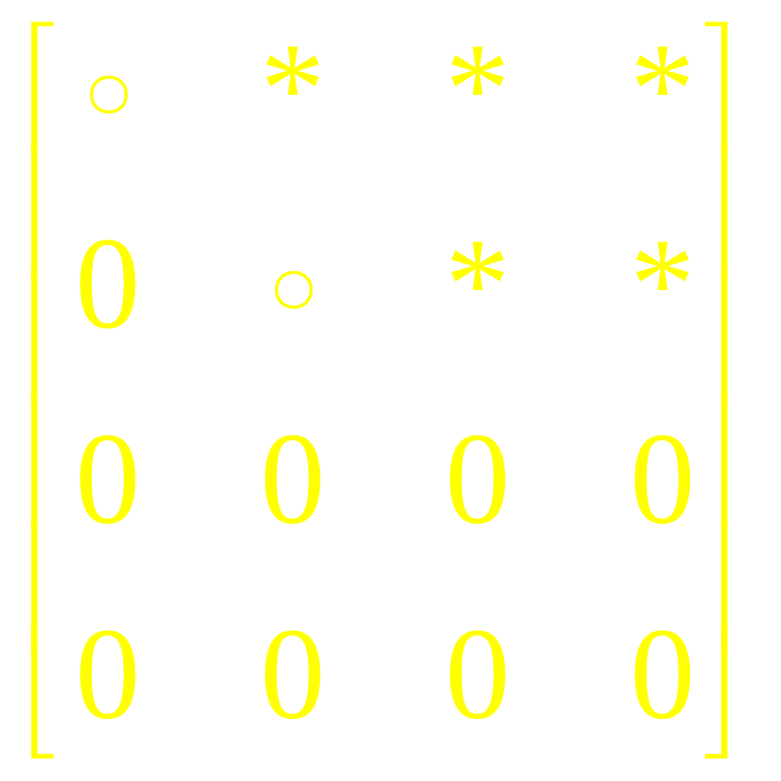
Examples

Slide 6
Reduced Echelon Form
The leading entry in each nonzero row is 1.
Each leading 1 is the only non-zero entry in its column.

Slide 7
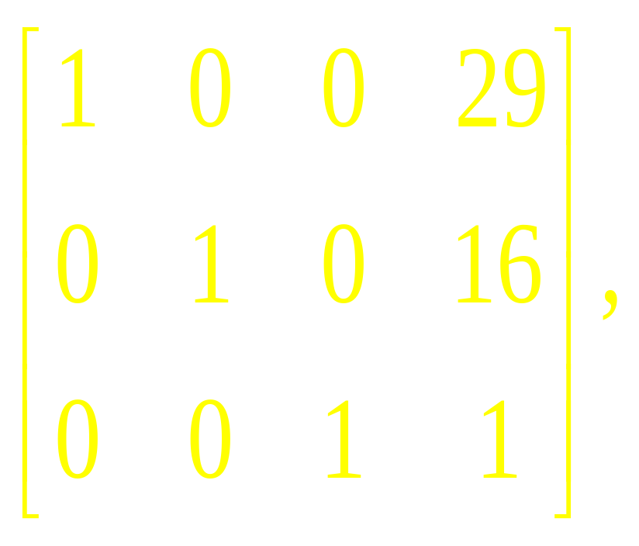
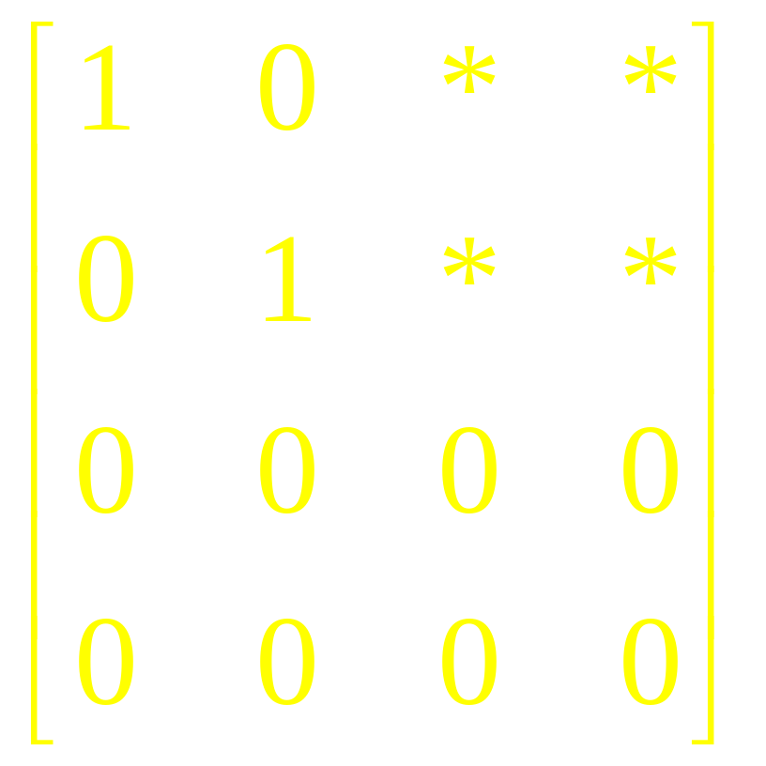
Examples

Slide 8
Theorem
Each matrix is row equivalent to one and only one reduced echelon matrix

Slide 9
Definitions
A pivot position in a matrix A is a location in A that corresponds to a leading entry in an echelon form of A.
A pivot column is a column of A that contains a pivot position.

Slide 10
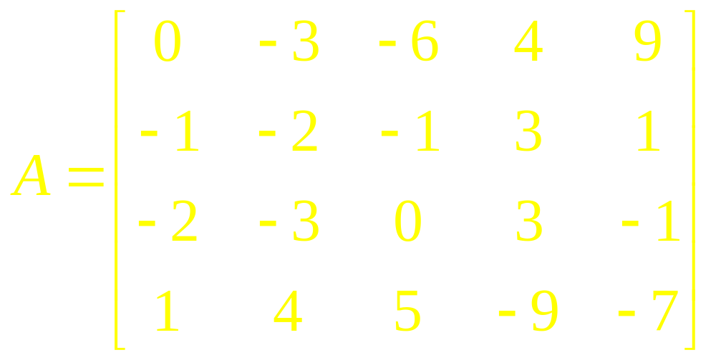
Example
Reduce the matrix A below to echelon form, and locate the pivot columns

Slide 11
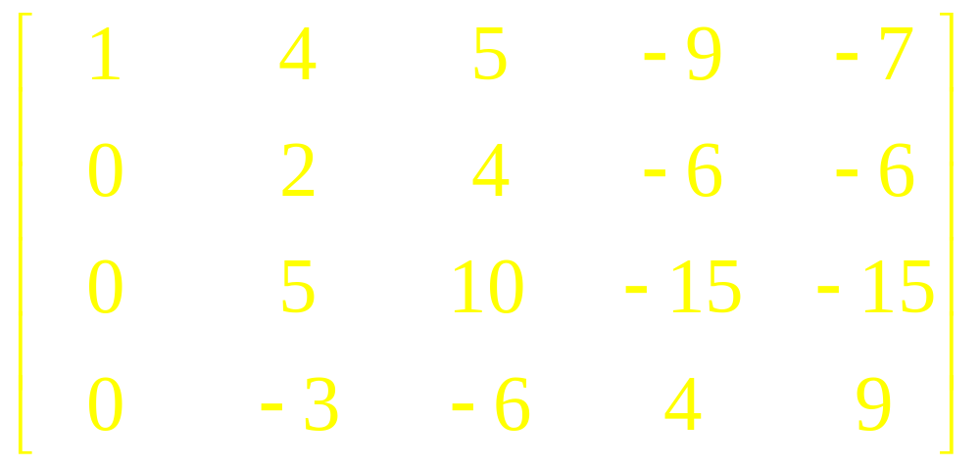
Solution

Slide 12
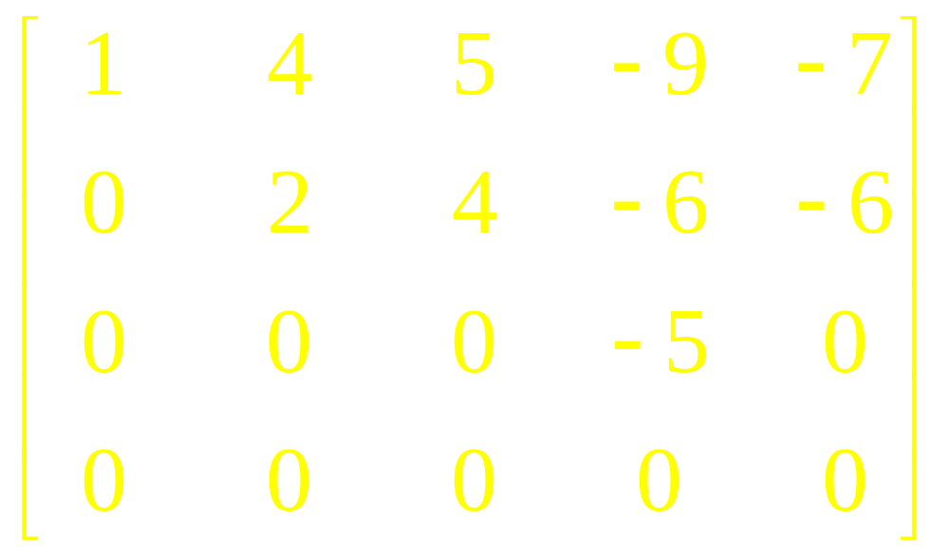
Solution
Echelon Form

Slide 13
Row Reduction Algorithm
Row Reduction Algorithm consists of four steps, and it produces a matrix in echelon form.
A fifth step produces a matrix in reduced echelon form.

Slide 14
Row Reduction Algorithm
STEP 1
Begin with the leftmost nonzero column. This is a pivot column. The pivot position is at the top.

Slide 15
Row Reduction Algorithm
STEP 2
Select a nonzero entry in the pivot column as a pivot. If necessary, interchange rows to move this entry into the pivot position

Slide 16
Row Reduction Algorithm
STEP 3
Use row operations to create zeros in all positions below the pivot

Slide 17
Row Reduction Algorithm
STEP 4
Cover (ignore) the row containing the pivot position and cover all rows, if any, above it
Apply steps 1 –3 to the sub-matrix, which remains.
Repeat the process until there are no more nonzero rows to modify

Slide 18
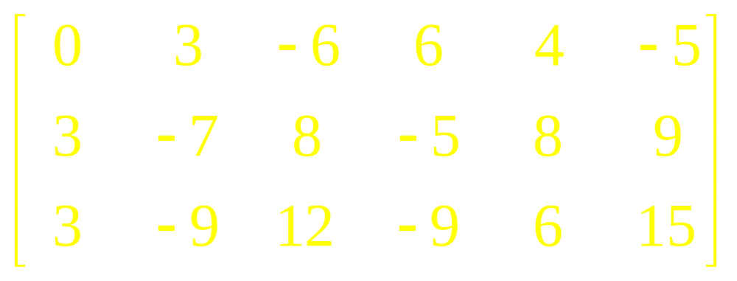
Example

Slide 19
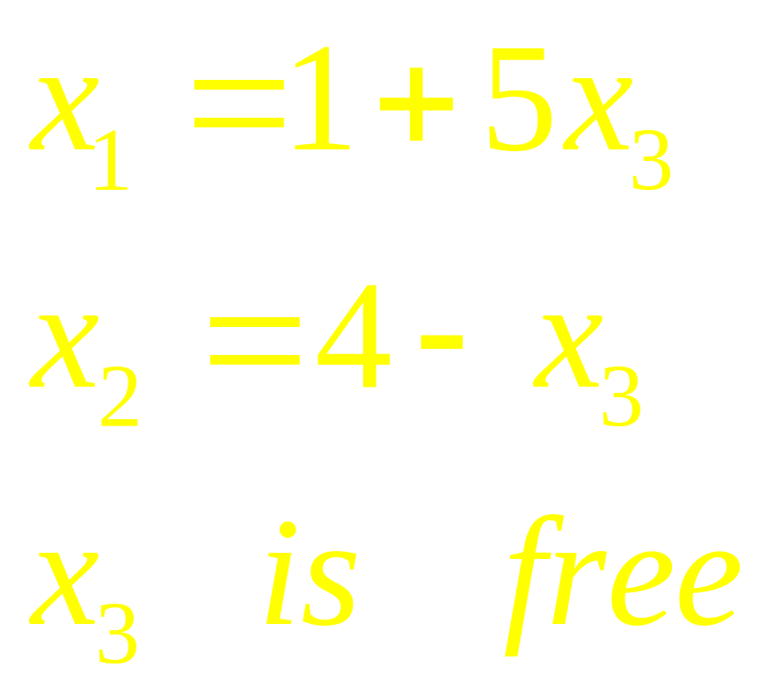
Answer

Slide 20
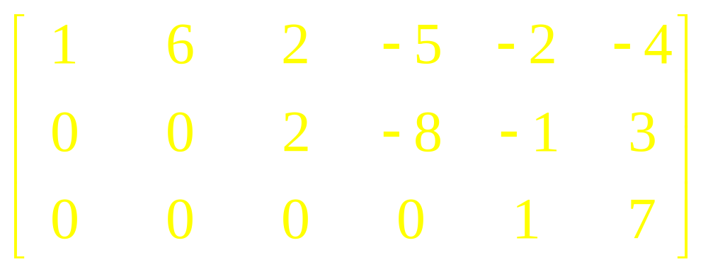
Example

Slide 21
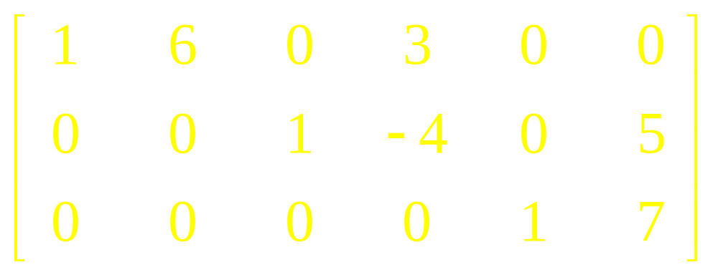
Reduced Echelon Form

Slide 22
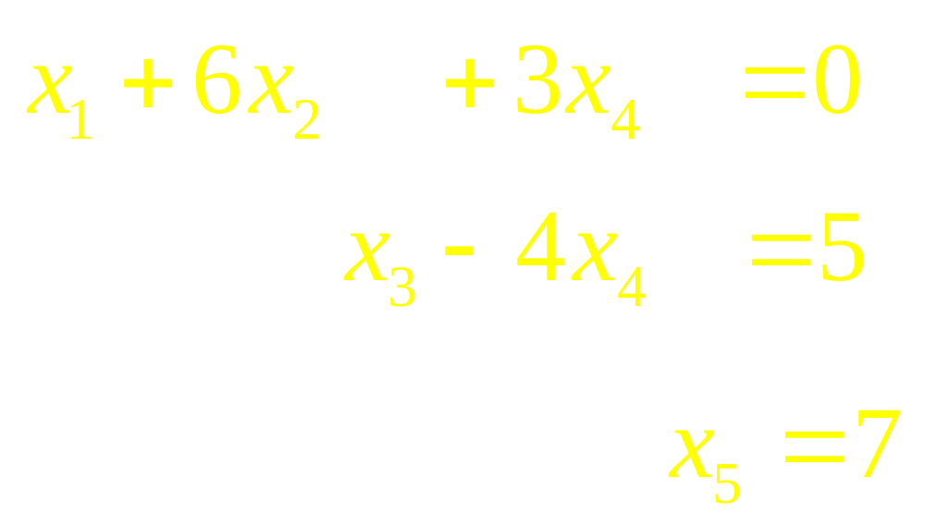
Associated System

Slide 23
Using Row Reduction to Solve a Linear System
Write the augmented matrix of the system
Use the row reduction algorithm to obtain an equivalent augmented matrix in echelon form.
Decide whether the system is consistent. If there is no solution, stop; otherwise go to next step.
Continue row reduction to obtain the reduced echelon form.

Slide 24
Using Row Reduction to Solve a Linear System
Continue row reduction to obtain the reduced echelon form.
Write the system of equations corresponding to matrix obtained in step 3.
Rewrite each non zero equation from step 4 so that its one basic variable is expressed in terms of any free variables appearing in equation

Slide 25
Linear Algebra
Lecture 4

